Slide 1
Fandango Movie Rating Discrepancy Analysis
CAPSTONE PROJECT
Presented By:
1. Manojin S – Lord Jegannath College Of Engineering And Technology - BE Civil Engineering 3rd Year.

Slide 2
OUTLINE
Problem Statement
Proposed System/Solution
System Development Approach
Algorithm & Deployment
Result
Conclusion
Future Scope
References

Slide 3
Problem Statement
Movie dataset for binary sentiment classification containing substantially more data than previous benchmark datasets. We provide a set of 25,000 highly polar movie reviews for training and 25,000 for testing. So, predict the number of positive and negative reviews using either classification or deep learning algorithms.

Slide 4
Proposed Solution
For the Fandango Capstan Project, a proposed solution would involve a comprehensive analysis of Fandango’s movie rating and ticket sales system to identify and address any potential biases or conflicts of interest. Data Acquisition Data Cleaning and Preparation Exploratory Analysis Statistical Analysis Algorithm Development Solution Implementation Reporting and Visualization This proposed solution aims to enhance the transparency and fairness of Fandango’s rating system, ultimately leading to a more trustworthy platform for consumers

Slide 5
System Approach
Problem Definition: Clearly define the problem you want to address. In this case, it’s understanding Fandango’s ticket sales model and assessing any potential bias or conflict of interest. Data Collection: Gather relevant data related to movie ratings, ticket sales, and other relevant factors. Data Preprocessing: Clean the data by handling missing values, outliers, and inconsistencies. Exploratory Data Analysis (EDA): Explore the data to understand its distribution, relationships, and any patterns. Hypothesis Testing: Formulate hypotheses related to Fandango’s ticket sales model. Model Building: Develop models to predict ticket sales or assess the impact of different factors. Evaluation Metrics: Define appropriate evaluation metrics based on the project’s objectives.. Interpretation and Insights: Interpret the results from your analysis. Provide actionable insights for stakeholders.

Slide 6
Algorithm & Deployment
algorithm related to this project, it would typically involve data collection, cleaning, analysis, and visualization steps. Here’s a high-level overview of what such an algorithm might look like:
Data Collection: Gather movie ratings and ticket sales data from Fandango and other relevant sources.
Data Cleaning: Preprocess the data to handle missing values, outliers, and inconsistencies.
Data Analysis: Use statistical methods to analyze the data and identify any patterns or anomalies.
Visualization: Create charts and graphs to visually represent the findings of the analysis.
Interpretation: Draw conclusions from the data analysis and visualization to understand the ticket sales model’s impact on movie ratings.

Slide 7
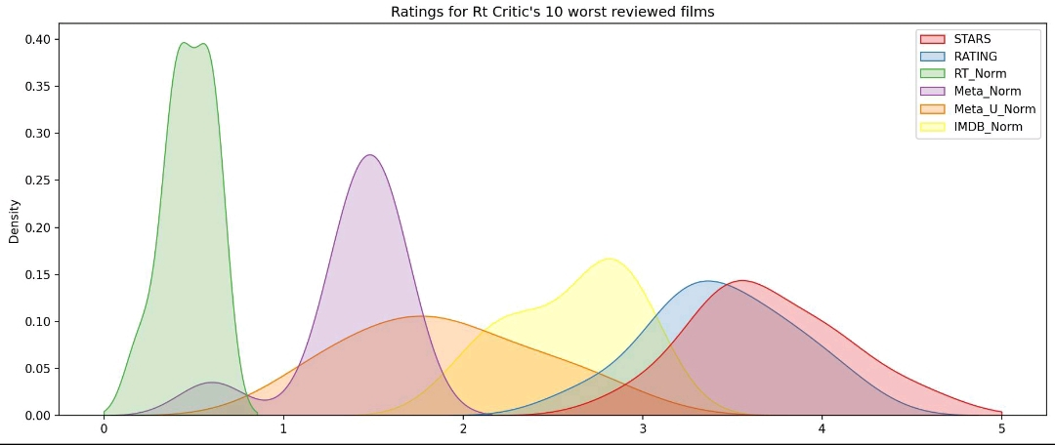
Result

Slide 8
Conclusion
Fandango's key services have been able to expand into new platforms, while the company continues to acquire other media businesses and grow its global footprint. Because it is not a traditional exhibition com pany, Fandango's success seems to be in direct opposition to the theatrical chains currently operating in the domestic marketplace

Slide 9
Future scope
Today, Fandango seems stronger than ever given the diversified company that it has become as well as the security it has as part of a large media conglomerate. Fandango's key services have been able to expand into new platforms, while the company continues to acquire other media businesses and grow its global footprint. Because it is not a traditional exhibition com- pany, Fandango's success seems to be in direct opposition to the theatrical chains currently operating in the domestic marketplace. It is difficult to imagine a more turbulent time for movie theaters than the last few years as box office returns continue to wane and streaming services proliferate. Domestic box office for 2019 overall decreased 4%, while many of the major studios such as Universal saw drops of 16% or more for the year

Slide 10
References
Barnes, “Disney Selling Film Tickets on Facebook, 2010
. Orwall, “Theatres Plan Web Venture, 2000. Bond, “Fandango. Movie Tickets, 2010. https://www.multichannel.com/news/comcast-considers-internet-video-push- 332553 Edgerton, Gary. “The Multiplex: The Modern American Motion Picture Theater as Message.” Journal of Popular Film and Television Bond, Paul. 2013. “CinemaCon: Fandango Adds 500 Screens. Hollywood Reporter. April 16. https://www.hollywoodreporter.com/news/cinemacon-fandango-adds-500- screens

Slide 11
THANK YOU

